Slide 1
01 / 15
PRE-SEED Perff .inc
MENA Spends Billions on Ads. Almost None of It Is Performance-Based.
We fix that.
The region's e-commerce market grows 15% annually — faster than any major market — yet captures barely 2% of the $18B global affiliate marketing industry. That gap is our opportunity.
15%
2%
$1.5B
335×
MENA E-com Growth
Affiliate Capture
MENA SAM
CAC Premium
FASTEST GLOBALLY
VS 15% IN WEST
GROWING 25%+ YoY
VS AFFILIATE CHANNEL
CONFIDENTIAL — Perff AI © 2026

Slide 2
02 / 15
WHAT WE DO
The Shopify of Affiliate Marketing for the Middle East.
Perff AI is an AI-powered platform connecting brands with affiliate publishers — automating campaign matching, fraud detection, and performance optimization so brands pay only for real results.
🏢 Brand → 🧠 Perff AI → 📱 Publisher → 👤 Customer → 💰 Everyone Paid
🎯
🛡️
⚡
AI-Powered Matching
Fraud Detection
Real-Time Optimization
Automatically connects brands with highest-performing publishers
Multi-layer protection against VPN masking, click farms, bot traffic
Predictive campaign scoring, automated budget reallocation
CONFIDENTIAL — Perff AI © 2026

Slide 3
03 / 15
PROOF — TRACTION
50+ Enterprise Brands. $50M+ in Sales Driven.
Real revenue, real clients, real results. Not a concept — a proven business growing 35% year-over-year.
870+
$50M+
8.2%
87%
35%
1.2M+
Publishers
Sales Driven
Conversion Rate
Retention
YoY Growth
Qualified Leads
LARGEST IN MENA
FOR BRANDS
3–8× INDUSTRY
+20pts ABOVE AVG
2.5× MARKET
GENERATED
Trusted by MENA's leading brands across 9 verticals
noon · Talabat · NAMSHI · DAMAC · Trendyol · OSN · StarzPlay · HYCM · Evest
eyewa · Homzmart · 6thStreet · OUNASS · SIVVI · Mumzworld · Level Shoes · NBA Store
Calo · DailyMealz · MultiBank · hummel · Courir · Go Sport · Nice One · Temu · Styli
CONFIDENTIAL — Perff AI © 2026

Slide 4
04 / 15
THE PROBLEM
15% E-Commerce Growth. 2% Affiliate Capture.
MENA's digital economy is booming but the performance marketing infrastructure is broken — or simply doesn't exist.
🏢 FOR BRANDS
📱 FOR PUBLISHERS
❌ 80% of MENA brands have zero affiliate programs
❌ CAC 335× higher than affiliate benchmarks
❌ No reliable platform to find publishers
❌ Fraud rates 3–5× global average
❌ Manual tracking via spreadsheets & WhatsApp
❌ No Arabic-language optimization tools
❌ Zero reliable MENA-native platforms
❌ Payment delays of 60–120 days
❌ No data transparency or optimization tools
❌ Western tools ignore Arabic content
❌ No local payment rail support
❌ Fragmented market — no single platform
THE RESULT: Billions in ad spend → Unmeasurable ROI → Brands overpay → Publishers underearned → Market stays underdeveloped
CONFIDENTIAL — Perff AI © 2026

Slide 5
05 / 15
THE SOLUTION
One Platform. Complete Affiliate Ecosystem.
Perff AI replaces spreadsheets, WhatsApp groups, and manual tracking with an AI-powered platform that automates the entire affiliate lifecycle.
🎯
🛡️
⚡
AI Publisher Matching
Fraud Protection
Smart Optimization
ML analyzes publisher audiences and performance for optimal pairings
Multi-layer MENA-trained detection — VPN, click farms, bots
Real-time budget reallocation, predictive scoring, auto-reporting
8.2% CVR
3–5× Better
7.0× ROAS
📊
💰
🌍
Transparent Analytics
Reliable Payments
MENA-Native
Real-time dashboards, full attribution, conversion tracking
On-time via bank transfer, PayPal, local methods. #1 pain solved
Arabic-first, local currency, regional consumer intelligence
CONFIDENTIAL — Perff AI © 2026
Real-Time
64% Organic
4 Markets

Slide 6
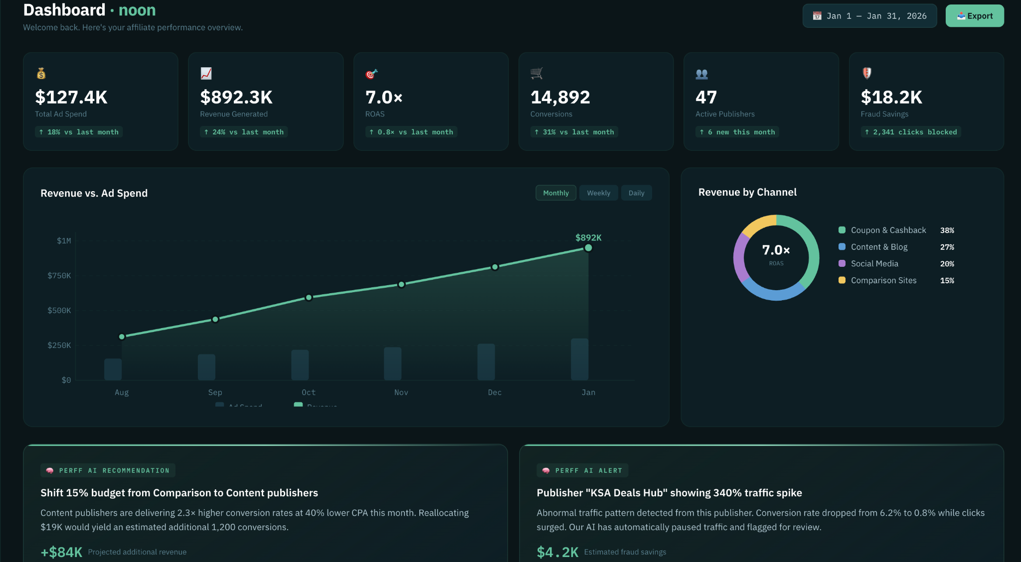

Slide 7
06 / 15
REVENUE MODEL
How We Make Money.
Performance-based revenue with built-in alignment — we only make money when our clients get results.
🏢 Brand Pays
🧠 Perff AI Keeps
📱 Publisher Earns
Per conversion (CPA/CPS)
→
Performance margin
→
Commission payout
$100
$20–35
$65–80
PRIMARY — LIVE
SCALING — BUILDING
HIGH-TOUCH — LIVE
Performance Margin
SaaS Features
Managed Services
Brand pays per conversion. Perff AI keeps the spread. 20–35% gross margin on every transaction.
Premium AI tools — predictive scoring, fraud detection, API access. Subscription-based recurring revenue.
Full-service affiliate program management for enterprise brands entering MENA.
90%+ of Revenue
Launching 2026
Select Clients
CONFIDENTIAL — Perff AI © 2026

Slide 8
07 / 15
MARKET OPPORTUNITY
A $30 Billion Market. MENA Is the Fastest-Growing Piece.
Global affiliate marketing is projected to reach $30B by 2031. MENA's share is growing 25%+ annually.
TOTAL ADDRESSABLE MARKET
SERVICEABLE ADDRESSABLE MARKET
SERVICEABLE OBTAINABLE MARKET
$30B
$1.5B
$200M
Global affiliate marketing by 2031
MENA performance marketing
3-year target (UAE + KSA + Egypt)
7.7% CAGR
25%+ YoY GROWTH
OUR BEACHHEAD
📈
👥
📱
🏗️
15% E-com Growth
400M+ Under 30
>90% Smartphones
Vision 2030
Fastest major region globally
Digital-native consumers
GCC penetration rate
KSA e-commerce push
CONFIDENTIAL — Perff AI © 2026

Slide 9
08 / 15
COMPETITIVE LANDSCAPE
No One Owns MENA Affiliate Marketing.
The only question is whether the winner will be a MENA-native platform or a Western player adapting late.
Platform | MENA Focus | AI/ML | Arabic First | Publisher Network | Fraud Detection
Perff AI | ✅ 100% | ✅ Core | ✅ Yes | ✅ 870+ MENA | ✅ MENA-trained
CJ Affiliate | ❌ Minimal | ⚠️ Basic | ❌ No | ⚠️ Global, few MENA | ⚠️ Global only
Rakuten | ❌ None | ⚠️ Basic | ❌ No | ⚠️ Global focus | ⚠️ Not localized
Impact.com | ⚠️ Entering | ✅ Strong | ❌ No | ⚠️ Growing | ⚠️ Global models
Awin | ❌ None | ⚠️ Basic | ❌ No | ⚠️ EU/US-focused | ⚠️ Not MENA-tuned
ArabyAds | ⚠️ Partial | ❌ None | ⚠️ Partial | ⚠️ Smaller | ❌ None
Admitad | ⚠️ Some | ❌ Basic | ❌ No | ⚠️ Global | ⚠️ Basic
OUR MOAT: 870+ MENA publishers · MENA-trained AI · Arabic-first platform · 50+ enterprise relationships · 250+ campaign dataset · Local payment infrastructure
CONFIDENTIAL — Perff AI © 2026

Slide 10
09 / 15
TECHNOLOGY & FLYWHEEL
The AI Gets Smarter With Every Campaign.
Every campaign trains our models. Every publisher adds data. Every brand deepens our understanding. This creates a compounding advantage competitors would need years to replicate.
🏢 More Brands
→
📊 More Data
→
🧠 Smarter AI
→
📈 Better Results
→
📱 More Publishers
AI — LIVE TODAY
AI — PLANNED (POST-INVESTMENT)
✅ Fraud detection MVP (MENA-specific patterns)
✅ Predictive campaign scoring
✅ Automated performance reporting
✅ Budget optimization recommendations
✅ Publisher-brand matching algorithms
🔨 Multi-layer fraud detection v2
🔨 Adaptive real-time budget allocation
🔨 Publisher recommendation engine
🔨 Self-serve brand dashboard with AI assistant
🔨 Open API for programmatic access
🔨 NLP-based Arabic content analysis
CONFIDENTIAL — Perff AI © 2026

Slide 11
10 / 15
EXPANSION ROADMAP
UAE → KSA → Egypt → Pan-MENA.
Proven playbook in UAE. Now expanding to the region's two largest markets — Saudi Arabia and Egypt.
2022
Foundation — UAE Launch
Founded in Abu Dhabi · First brand clients · 200+ publishers · ~$200K revenue
2023
Growth — Enterprise Penetration
Signed noon, Talabat, DAMAC · Revenue 3× to $600K · 500+ publishers · Fraud detection MVP
2024
Scale — Market Leadership
Revenue 2× to $1.2M · 50+ enterprise brands · 620+ publishers · 17.5% market share (UAE/KSA)
2025
Investment — Pre-Seed Round
$1.8M projected revenue · Self-serve dashboard · Begin KSA expansion · Raise $8M pre-seed
2026
Expansion — KSA + Product
Riyadh office · Full AI platform launch · 1,500+ publishers · $3.5M revenue · API launch
2027
Scale — Pan-MENA
Egypt launch · 2,000+ publishers · $8–9M revenue · SaaS revenue stream live
CONFIDENTIAL — Perff AI © 2026

Slide 12
11 / 15
FINANCIAL PERFORMANCE
Revenue 6× in 3 Years. Self-Funded.
Built to $1.8M revenue with zero outside cash. Capital-efficient founders who know how to do more with less.
$8–9M
$3.5M
$1.8M
$1.2M
$600K
$200K
2022
2023
2024
2025E
2026P
2027P
Gross Margin
Net Revenue Retention
Revenue per Employee
20–35%
~120%
$200K
Performance margin, growing with AI
Existing clients increase spend YoY
$1.8M revenue ÷ 9 team members
CONFIDENTIAL — Perff AI © 2026

Slide 13
12 / 15
THE TEAM
Built by MENA Insiders Who Know This Market.
10+ years of MENA performance marketing experience. A previous exit. Deep brand relationships.
RH
Rima Hani
FA
Fahad Alsaedi
SC
Sadah Chanti
Co-Founder & CEO
Co-Founder & CTO
Co-Founder & COO
10+ years leading performance marketing across MENA. Built and scaled affiliate programs for the region's largest brands.
Serial technical founder with a previous exit. Former engineering lead at Nana (nana.sa). Deep expertise in scalable platforms & AI/ML.
Bilingual Regional Head of Communications with 17+ years leading high-performing teams across content, video, and account management.
Ex-Equiti · Ex-DigiZag · Abu Dhabi
1× Exit · Ex-Nana · MBIT · Saudi Arabia
17+ Years · Communications · Riyadh, KSA
CORE TEAM
Amer Kilani
Abeer Hani
Fairouz Hamdan
Samer Baibers
Mohammed Alshaikh
Lilian Alfar
General Manager
Head of Communications
Social Media Manager
Sr. Affiliate Manager
Sr. Affiliate Manager
Sr. Affiliate Account Exec
📍 Amman
📍 Riyadh
📍 Amman
📍 Amman
📍 Gaza
📍 Amman
CONFIDENTIAL — Perff AI © 2026

Slide 14
13 / 15
THE ASK
$8,000,000 Pre-Seed to Build the Category.
We're raising $8M to build the definitive AI-powered affiliate marketing platform for MENA — before the window closes.
AI Development — ML Engineers, Infrastructure, Training
40% · $3.2M
Regional Expansion — KSA (Riyadh), Egypt (Cairo), Sales Teams
35% · $2.8M
Marketing & Growth — Brand Acquisition, Publisher Growth, Events
25% · $2.0M
12-MONTH MILESTONES
24-MONTH MILESTONES
✅ Full Perff AI platform GA launch
✅ 3 ML engineers hired and shipping
✅ KSA market entry — Riyadh office
✅ 1,500+ publisher network
✅ Self-serve brand dashboard live
✅ $4M+ revenue run rate
✅ Egypt market entry — Cairo office
✅ 2,000+ publisher network
✅ Full AI stack deployed (fraud v2, scoring, API)
✅ SaaS revenue stream live
✅ $8–9M revenue run rate
✅ Series A ready
CONFIDENTIAL — Perff AI © 2026

Slide 15
14 / 15
WHY NOW
The Window Is 18–24 Months.
Five macro forces are converging to create a once-in-a-decade opportunity in MENA affiliate marketing.
🛒
🏗️
🧠
E-Commerce Boom
Vision 2030
AI Inflection
MENA e-commerce growing 15% YoY. $50B+ market. Every brand needs efficient acquisition.
Saudi Arabia investing billions in digital infrastructure. New e-commerce brands launching monthly.
Gen-AI and ML tools now accessible. Our 250+ campaign dataset gives us a head start.
💸
🌍
⏰
CAC Crisis
No Incumbent
First-Mover Window
Facebook/Google CPAs rising 30%+ YoY in MENA. Brands seeking performance alternatives.
No dominant affiliate platform in MENA. Western players haven't localized.
International platforms will enter MENA within 18–24 months. We must lead now.
CONFIDENTIAL — Perff AI © 2026

Slide 16
15 / 15
LET'S BUILD THE FUTURE OF MENA PERFORMANCE MARKETING
Turn MENA's Ad Spend Into Measurable Growth.
Raising
Revenue
Brands
Publishers
$8M
$1.8M
50+
870+
Rima Hani
Co-Founder & CEO
rima.hani@globalnetwork.global
perff.net USA (HQ) · Abu Dhabi, UAE · Amman, Jordan · Riyadh, KSA · Gaza, Palestine UAE: +971 506856839 · Jordan: +962 796314887
© 2026 Perff AI (Perff Inc.). Confidential & Proprietary.
CONFIDENTIAL — Perff AI © 2026

